Slide 1
Extended Euclidean Algorithm in C
By Rodolfo "Ofo" Croes

Slide 2
Contents
Brief explanation of the Extended Euclidean Algorithm
How this is used to solve ax = congruent b (mod n) with all possible x's
Steps to implement the Algorithm in C
Demonstration of code executing

Slide 3
Extended Euclidean Algorithm
The extended Euclidean algorithm is an algorithm to compute integers x and y such that:
ax + by = gcd(a,b)
By reversing the steps in the Euclidean algorithm, it is possible to find these integers x and y.

Slide 4
How does one do this?
First, we use Euclidean Algorithm to solve for the gcd(a, b)
Then, using the results of this, we work backwards starting with the gcd, and we keep going until we get:
gcd(a,b) = a(x) + b(y)
Where x and y are the multiplicative inverses of a and b

Slide 5
Solving ax = congruent b (mod n)
Firstly, we need to find out how many solutions this has by checking if the gcd(a,n) divides b.
If b does not, then there is no solution for x
If b does, then the gcd(a,n) is equal to the amount of solutions
If the gcd(a,n) = 1, we find the multiplicative inverse of a by using backwards substitution.
Then calculate x using: x = a⁻¹ (b) (mod n)

Slide 6
Solving ax = congruent b (mod n) (cont.)
When gcd(a,n) > 1, we divide a, b, and n by the gcd(a,n) to get new values for a*, b* and n*
Then using these new a*, b* and n* we calculcate the gcd(a*, n*) which equals to 1
Use backwards substitution on the new gcd to get a⁻¹
Calculate the first value of x with x = a⁻¹ (b) (mod n)

Slide 7
Solving ax = congruent b (mod n) (cont.)
Use n/c where n is the mod and c is the gcd(a,n) to find the gap between each unique answer for x.
Add n/c to x until we get n amount of unique solutions for x

Slide 8
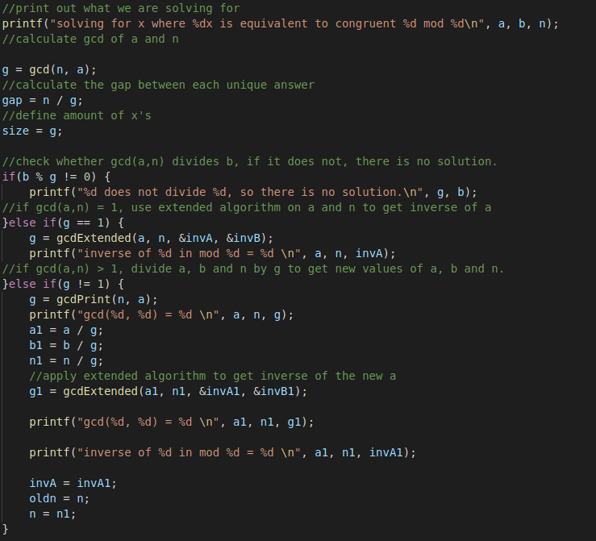
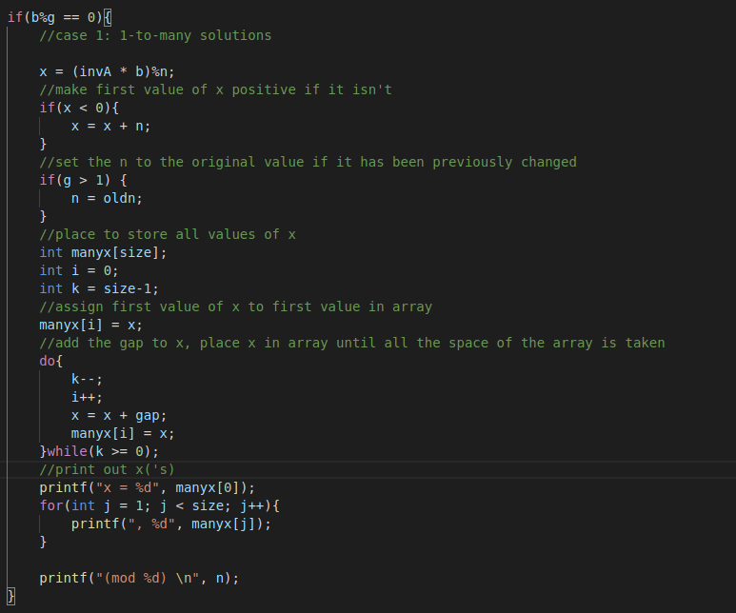
Implementation in C
Find inverse of a:
Value(s) of x:

Slide 9
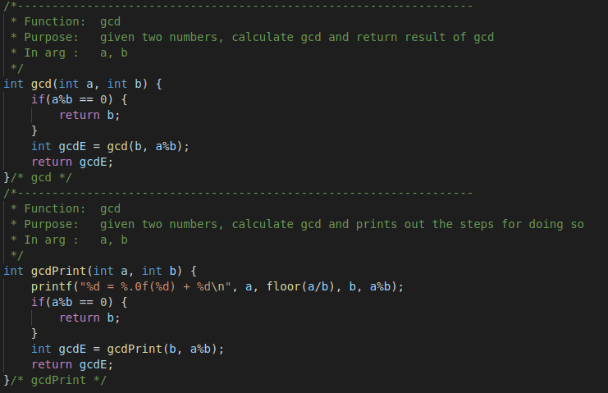
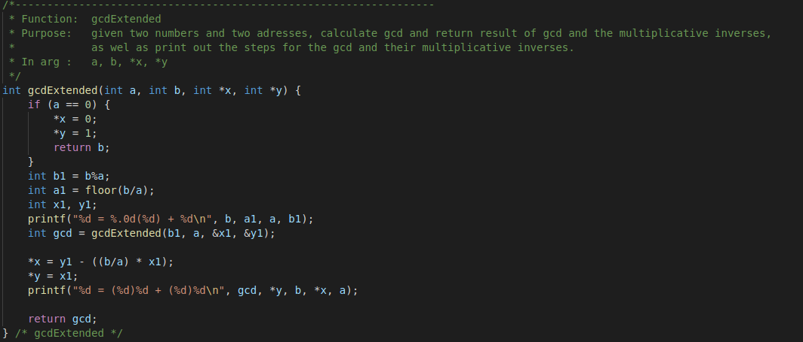
Implementation in C (cont.)
gcd function:
gcdExtended function:

Slide 10
gcdExctended calculation
invA and invB are results for inputs a and b, a(invA) + b(invB) = gcd
And A and B are results for inputs b%a and a (b%a)A + (a)B = gcd
When we put b%a = (b - (⌊b/a⌋).a) in above, we get following (b-(⌊b/a⌋)a)A + (a)B = gcd
Above equation can also be written as (b)A + (a)B - (⌊b/a⌋)A) = gcd

Slide 11
gcdExctended calculation (cont.)
After comparing coefficients of 'a' and 'b' in 1 and 4, we get following invA = B - ⌊b/a⌋ * A invB = A

Slide 12
Questions?

